Slide 1

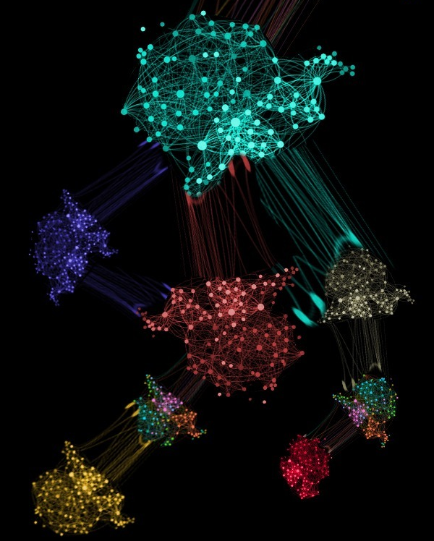
Lab 2: Unsupervised Learning
K-Means, Gaussian Mixture Models (GMM), Expectation Maximization (EM)
Machine Learning and Deep Learning 2023
Eros Fanì & Debora Caldarola
eros.fani@polito.it, debora.caldarola@polito.it

Slide 2
Unsupervised learning
What is unsupervised learning?
Introduction to clustering
Introduction
Metrics
K-Means
how does it work?
PROs, CONs
GMMs
what is a GMM?
How does it differ from K-means?
PROs, CONs

Slide 3
Unsupervised Learning
Goal: discover patterns or structure within a dataset without the use of explicit labels or guidance
Identify the hidden structure behind the data
No feedback mechanism for the algorithm to determine how close or far it is from the optimal solution

Slide 4
Unsupervised Learning
Input dataset X = {x1, x2, ..., xn}, xi ∈ R^m
Goal: find f: X→Y mapping the input data to a set of output variables Y
f is not provided with explicit target variables or labels
f should discover underlying patterns, structure or relationships within the data
f should be able to generalize to new, unseen data
Particularly useful for problems where the desired outcome is not known in advance
EXAMPLES
clustering
dimensionality reduction
anomaly detection

Slide 5
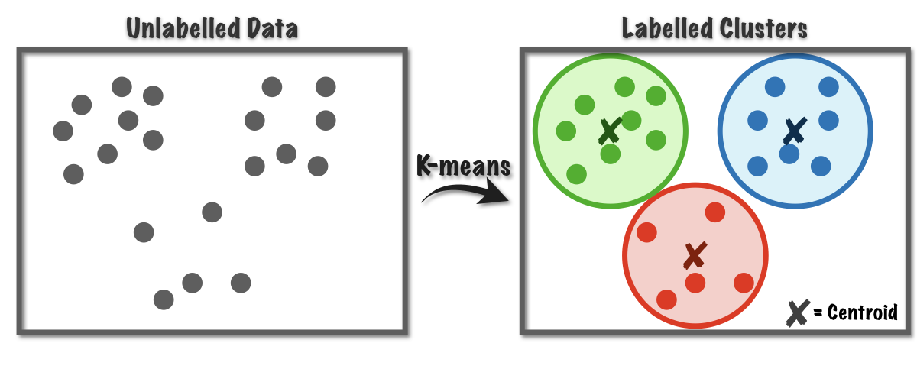
Clustering
Unsupervised ML technique involving grouping similar data points together based on their similarity or distance from each other
Goal: identify natural groupings, or clusters, in a dataset without any prior knowledge or labels
Good clusters if:
high intra-cluster similarity
low inter-cluster similarity
EXAMPLES:
k-means clustering
hierarchical clustering
DBSCAN clustering
density-based clustering (GMM)

Slide 6
Clustering metrics
SUPERVISED CLUSTERING METRICS:
Require true labels to be computed
Examples: homogeneity, completeness, V-measure
UNSUPERVISED CLUSTERING METRICS:
Do not require true labels to be computed
Example: Silhouette coefficient
https://scikit-learn.org/stable/modules/clustering.html#homogeneity-completeness https://scikit-learn.org/stable/modules/clustering.html#silhouette-coefficient

Slide 7
K-Means
Sample K centroids randomly
Assign each sample to the nearest centroid
Compute new cluster centroids
Repeat until convergence
PROs:
Simple and efficient
Scalable
Interpretable results
Flexible
Guaranteed to converge
CONs:
Sensible to initialization
Difficult to choose K
Sensitive to outliers
Limited to linear boundaries
Biased towards equal-sized clusters
Only handles numerical data
Assumes spherical clusters

Slide 8
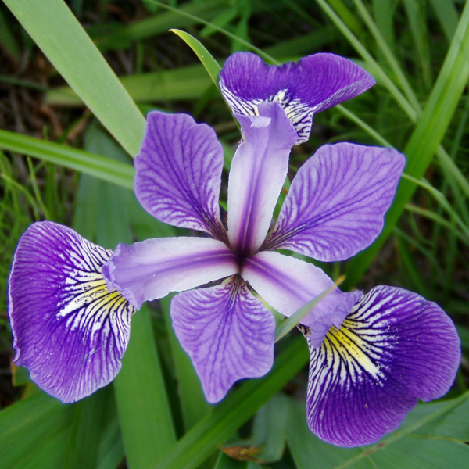
Exercise 1: K-Means with Sklearn
Explore the K-means algorithm on the Iris dataset
Import the Iris dataset
Evaluate K-means with 3 clusters (= 3 real labels: Virginica, Versicolour, Setosa) with several random seeds
How does the random initialization of the centroids affect the final clusters?
Evaluate K-means with a fixed random seed, with K = 2, 3, … 20
What is the best K according to the supervised clustering metrics? And according to the unsupervised clustering metrics? Why?
Reduce the data with PCA and apply k-means again. Visualize the results using PCA with 2 components (suggestion: use the script in the next slides)

Slide 9
How to visualize the results (1/3)
import matplotlib.pyplot as plt
from sklearn.decomposition import PCA
import numpy as np
reduced_data = PCA(n_components=2).fit_transform(iris.data)
kmeans_model.fit(reduced_data)
# Step size of the mesh. Decrease to increase the quality of the VQ.
h = 0.02 # point in the mesh [x_min, x_max]x[y_min, y_max].
# Plot the decision boundary. For that, we will assign a color to each
x_min, x_max = reduced_data[:, 0].min() - 1, reduced_data[:, 0].max() + 1
y_min, y_max = reduced_data[:, 1].min() - 1, reduced_data[:, 1].max() + 1
xx, yy = np.meshgrid(np.arange(x_min, x_max, h), np.arange(y_min, y_max, h))
# Obtain labels for each point in mesh. Use last trained model.
Z = kmeans_model.predict(np.c_[xx.ravel(), yy.ravel()])

Slide 10
How to visualize the results (2/3)
# Put the result into a color plot
Z = Z.reshape(xx.shape)
plt.figure(1)
plt.clf()
plt.imshow(
Z,
interpolation="nearest",
extent=(xx.min(), xx.max(), yy.min(), yy.max()),
cmap='Set2',
aspect="auto",
origin="lower",
)
plt.scatter(reduced_data[:, 0], reduced_data[:, 1], c=iris.target, cmap='Pastel2')
# Plot the centroids as a white X
centroids = kmeans_model.cluster_centers_

Slide 11
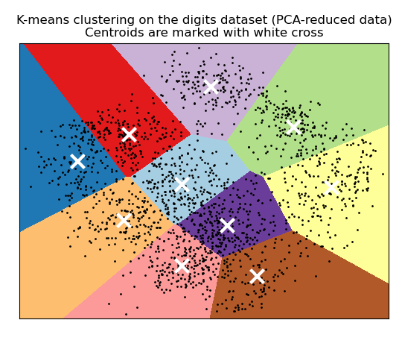
How to visualize the results (3/3)
plt.scatter(
centroids[:, 0],
centroids[:, 1],
marker="x",
s=169,
linewidths=3,
zorder=10,
)
plt.title(
"K-means clustering on the digits dataset (PCA-reduced data)\n"
"Centroids are marked with white cross"
)
plt.xlim(x_min, x_max)
plt.ylim(y_min, y_max)
plt.xticks(())
plt.yticks(())
plt.show()
Image from sklearn official tutorials

Slide 12
Tips
Remember to standardize the data
Refer to the following documentation:
https://scikit-learn.org/stable/auto_examples/datasets/plot_iris_dataset.html
https://scikit-learn.org/stable/modules/clustering.html#silhouette-coefficient
https://scikit-learn.org/stable/modules/generated/sklearn.preprocessing.StandardScaler.html
https://scikit-learn.org/stable/modules/generated/sklearn.cluster.KMeans.html
https://scikit-learn.org/stable/modules/generated/sklearn.decomposition.PCA.html

Slide 13
Gaussian Mixture Models (GMMs)
Overcoming the drawbacks of K-means
The idea behind GMMs
GMMs for handling not well separable data
GMMs for generating new data

Slide 14
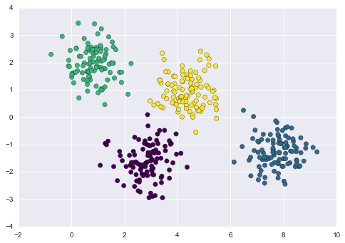
Main issues with K-means
Poor performance in real-world scenarios due to the distance-from-cluster idea used to determine cluster membership

Slide 15
Main issues with K-means
Poor performance in real-world scenarios due to the distance-from-cluster idea used to determine cluster membership
Given well separable data, K-means finds suitable clusters

Slide 16
Main issues with K-means
Poor performance in real-world scenarios due to the distance-from-cluster idea used to determine cluster membership
Given well separable data, K-means finds suitable clusters
What happens when there is some overlap?

Slide 17
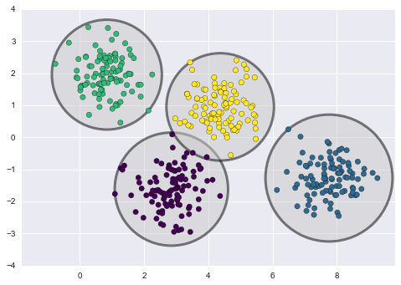
Main issues with K-means
Poor performance in real-world scenarios due to the distance-from-cluster idea used to determine cluster membership
Given well separable data, K-means finds suitable clusters
What happens when there is some overlap?
No measure of uncertainty cluster assignment

Slide 18
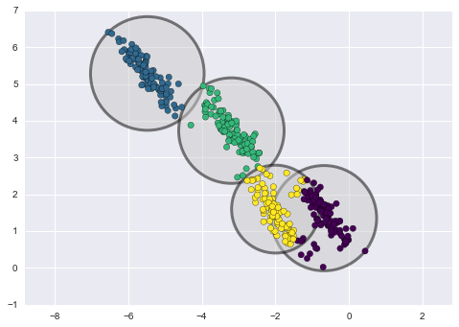
Main issues with K-means
Poor performance in real-world scenarios due to the distance-from-cluster idea used to determine cluster membership
Given well separable data, K-means finds suitable clusters
What happens when there is some overlap?
No measure of uncertainty cluster assignment
The clusters must be circular
… and they may not be a good fit to the data
Not flexible enough

Slide 19
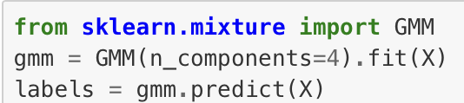
Gaussian Mixture Models (GMMs)
A Gaussian mixture model (GMM) attempts to find a mixture of multi-dimensional Gaussian probability distributions that best model any input dataset.

Slide 20
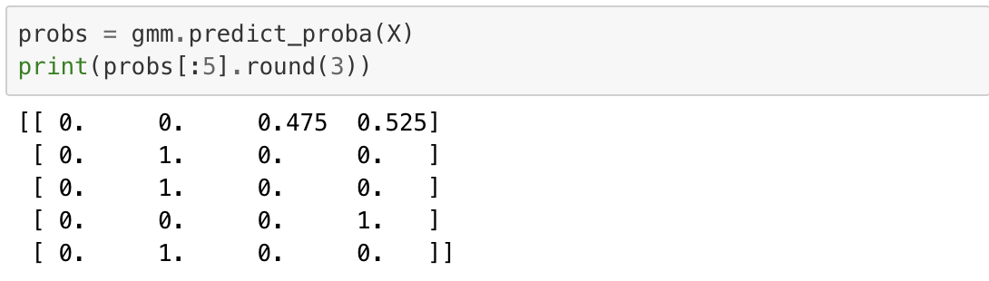
Gaussian Mixture Models (GMMs)
A Gaussian mixture model (GMM) attempts to find a mixture of multi-dimensional Gaussian probability distributions that best model any input dataset.
Each point belongs to the cluster with a given probability.
The position and the shape of each cluster are defined by mean and covariance.

Slide 21
GMMs in short
Based on an Expectation-Maximization approach.
Choose starting guesses for random assignments and shapes
Repeat until convergence:
E-step: for each point, find the weights encoding the probability of membership in each cluster
M-step: for each cluster, update its location, normalization, and shape based on all data points, making use of the weights
The resulting clusters are associated with a smooth Gaussian model, rather than a hard-edged sphere.
The optimal solution may be missed, so multiple random initializations are used.
No distance measures are used. The points are assigned to the clusters based on probability distributions.

Slide 22
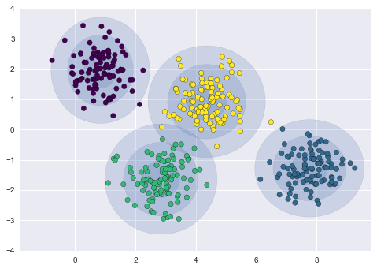
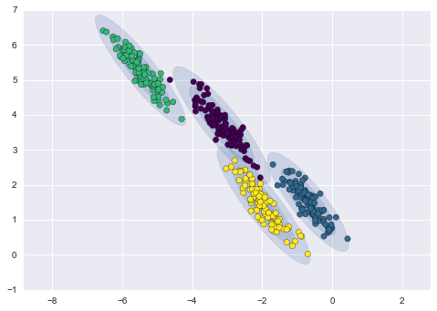
Example of resulting clusters with GMMs

Slide 23
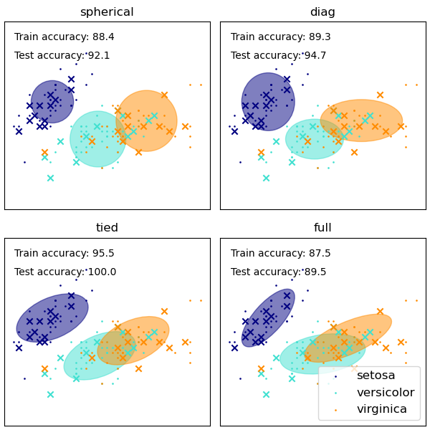
Relevant choices
Initialization - - to define the initial center of the model components
k-means (can be computationally heavy)
k-means++: pick first center at random, then subsequent centers are the most distant ones
random
Number of components
Covariance type (constraint on the estimated classes)
spherical
diagonal
tied
full covariance

Slide 24
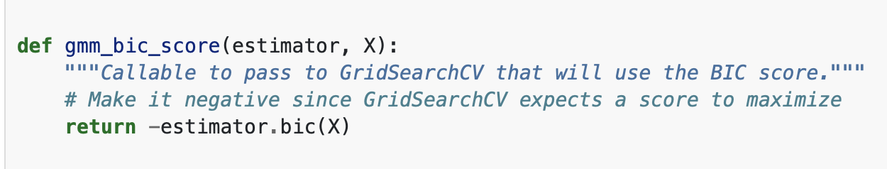
Exercise 2: GMMs
Build your first GMM to replicate the results obtained with K-means on the IRIS dataset
Suggestion: n_components is comparable to K
Try out the different initializations: how do the results differ?
Take a look here to see how to plot the obtained clusters.
Pick the best number of components by applying grid search. Use the negative BIC (Bayes Information Criterion) score as scoring method. Select the number of components having the lowest BIC.
In sklearn: GridSearchCV
Suggestion: define the function computing the BIC
score and pass it to the GridSearch
How does the choice of covariance type affect the results? How do the built clusters compare with the actual dataset?
Take a look at this tutorial

Slide 25
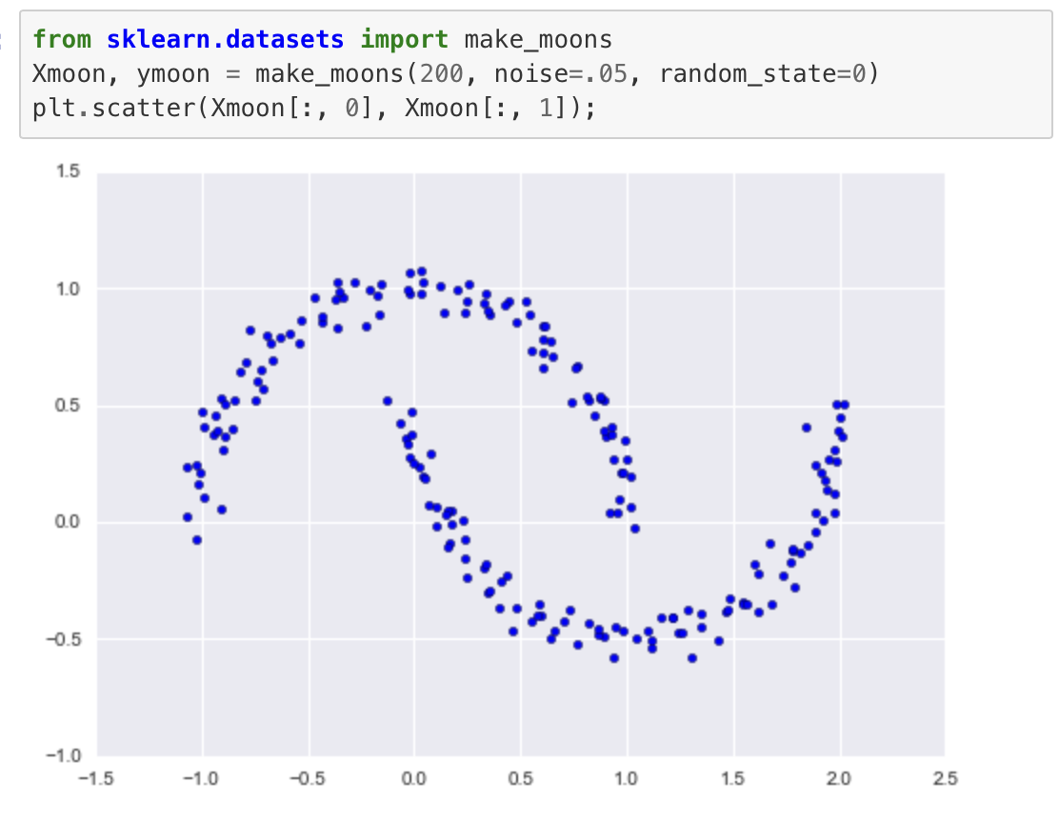
Exercise 3: Handling not well separable data
Setup the Moons dataset from sklearn as:
You should see something like
Using the function plot_gmm from the next slide, see what happens when moving from n_components=2 to n_components >= 16.
Is the GMM able to model the overall distribution of the input data?

Slide 26
Useful plotting functions
from matplotlib.patches import Ellipse
def draw_ellipse(position, covariance, ax=None, **kwargs):
"""Draw an ellipse with a given position and covariance"""
ax = ax or plt.gca()
# Convert covariance to principal axes
if covariance.shape == (2, 2):
U, s, Vt = np.linalg.svd(covariance)
angle = np.degrees(np.arctan2(U[1, 0], U[0, 0]))
width, height = 2 * np.sqrt(s)
else:
angle = 0
width, height = 2 * np.sqrt(covariance)
# Draw the Ellipse
for nsig in range(1, 4):
ax.add_patch(Ellipse(position, nsig * width, nsig * height,
angle, **kwargs))
def plot_gmm(gmm, X, label=True, ax=None):
ax = ax or plt.gca()
labels = gmm.fit(X).predict(X)
if label:
ax.scatter(X[:, 0], X[:, 1], c=labels, s=40, cmap='viridis', zorder=2)
else:
ax.scatter(X[:, 0], X[:, 1], s=40, zorder=2)
ax.axis('equal')
w_factor = 0.2 / gmm.weights_.max()
for pos, covar, w in zip(gmm.means_, gmm.covars_, gmm.weights_):
draw_ellipse(pos, covar, alpha=w * w_factor)

Slide 27
Exercise 4: GMMs for generating new data
A trained GMM describes the distribution of the input data.
Load the MNIST dataset (load_digits) and plot the first 30 samples (will serve as reference later)
GMMs might have troubles converging in high dimensional spaces. Apply PCA and preserve 99% of the variance.
How many principal components do you need to keep 99% of the variance?
Define and fit your GMM model:
Use BIC to select the best number of components to fit the reduced data. Try a few values in the range [10, 250].
Fit the GMM model with the best number of components to the reduced data. Check its convergence with gmm.converged_
It’s time to generate new data following the learned distribution!
Call the sample(n_new_samples) method on your GMM. The output should have dimensions (n_new_samples, n_PCs)
Apply the inverse transform the PCA to the obtained data to return to the original space
Plot the obtained digits: how similar are they to the original ones?

Slide 28
Some useful references
https://jakevdp.github.io/PythonDataScienceHandbook/05.12-gaussian-mixtures.html
https://scikit-learn.org/stable/modules/mixture.html
https://scikit-learn.org/stable/auto_examples/mixture/plot_gmm_pdf.html#sphx-glr-auto-examples-mixture-plot-gmm-pdf-py
https://towardsdatascience.com/implement-expectation-maximization-em-algorithm-in-python-from-scratch-f1278d1b9137

